Slide 1
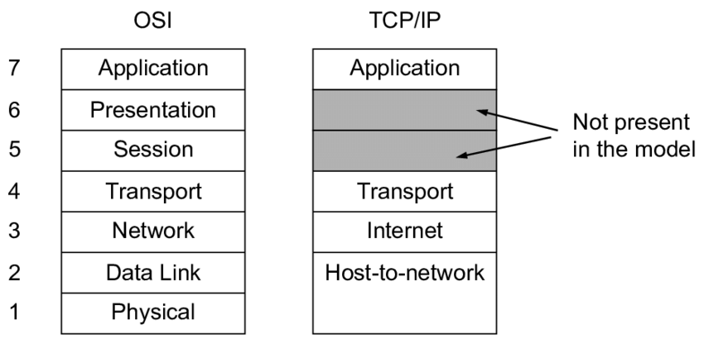
TCP/IP MODEL

Slide 2
The TCP/IP model was developed prior to the OSI model.
The TCP/IP model is not exactly similar to the OSI model.
The TCP/IP model consists of FOUR layers: the application layer, transport layer, INTERNET layer, HOST TO NETWORK LAYER.
TCP/IP is a hierarchical protocol made up of interactive modules, and each of them provides specific functionality

Slide 3
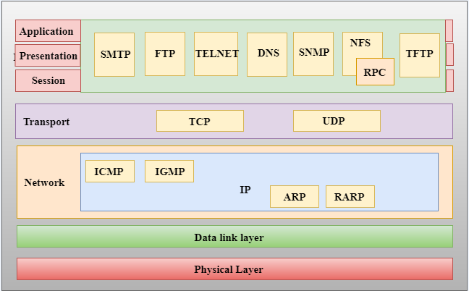

Slide 4
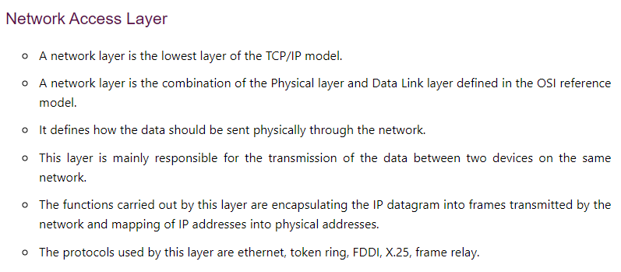

Slide 5
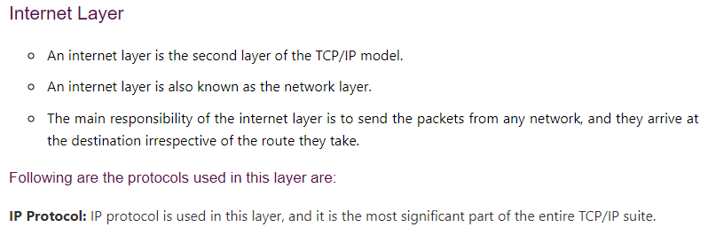

Slide 6
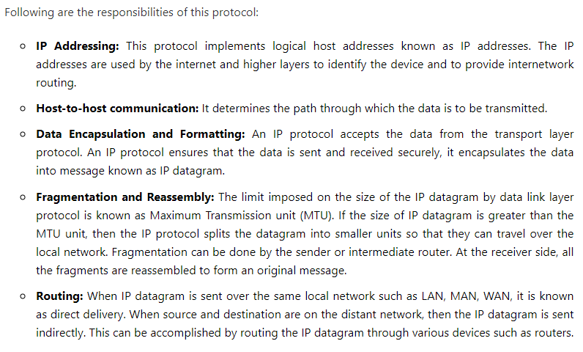

Slide 7
